Slide 1
Cooper Yungblut
Project Notebook

Slide 2
9/25/2018 from 3:30PM - 8:00PM
Division of labor decided, at least for now. Tasks will be split up and shared as we figure out more on how much time they will take.
GANTT chart base given by Joseph. Initial GANTT for our group edited by me. It needs some work.
Budget created by Lin.
After the basics were out of the way we began researching our topics and discussed what we would need to present on 9/26.
Joseph and I created a block diagram for the overall project.

Slide 3
9/25/2018 from 10:00PM to 2:00AM
Team working individually from home for presentation.
I researched Electronic Loads for a few hours.
Watched a few video tutorials over how to make one, most were not very helpful.
Found a resource from a Keysight Technologies blog post about how electronic loads worked. I tried to make their basic design for a Constant Current using LTSpice (next slide) but it didn’t want to work correctly, so I’m shelving it for now.
Kept in contact with group during this time to ensure we’d have a presentation ready by the 2AM deadline.

Slide 4
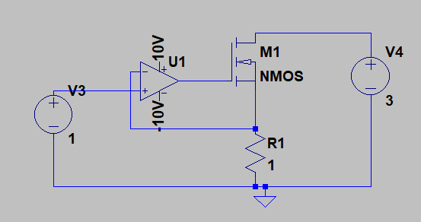
First Attempt at basic Constant Current Electronic Load Design
Did not want to perform correctly, probably need to get a more specific op-amp for LTSpice

